Slide 1
Brain-Based Learning Activities & Their Implications in the Classroom

Slide 2
Brain Study....
If you can read this you have a strong mind:
F1gur471v3ly 5p34k1ng
7H15 M3554G3
53RV35 7O PR0V3
H0W 0UR M1ND5 C4N
D0 4M4Z1NG 7H1NG5!
1MPR3551V3 7H1NG5!
1N 7H3 B3G1NN1NG
17 WA5 H4RD BU7
N0W, 0N 7H15 LIN3
Y0UR M1ND 1S
R34D1NG 17
4U70M471C4LLY
W17H 0U7 3V3N
7H1NK1NG 4B0U7 17,
B3 PROUD! 0NLY
C3R741N P30PL3 C4N
R3AD 7H15.

Slide 3
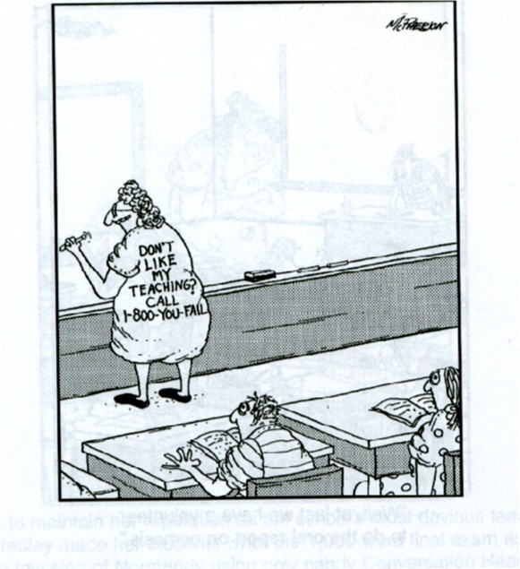
I guess this teacher never learned that good ones try to meet students needs. . .

Slide 4
Brain Facts
* The brain is naturally motivated; learning is a survival instinct.
* The brain is a pattern-seeking device. It is always looking for links
between what it is receiving and what is already stored.
Mnemonics work on this principle. Ex: Roy G. Biv, Dr. Lium Scren,
I before E …,the planets (My very…),
See MG men… (essential soil elements)
* The brain can do only one thing at a time unless one of the activities is
automatic. [why texting and driving is dangerous]
* The brain is not designed for continuous input. It needs time for
reflection, consolidation, and integration.
* The attentive brain needs novelty, contrast or a change in location
* Attention Span = learners age + 2 minutes for a maximum
of 30 minutes.

Slide 5
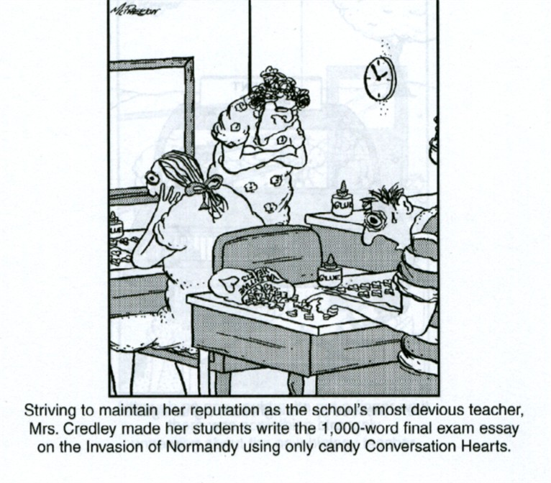
Humor is helpful
Humor is valuable in creating laughter which decreases stress, increases the flow of neurotransmitters needed for alertness and memory, and increases the effectiveness of the immune system.
A type of hands-on learning?

Slide 6
Connecting the Left & Right Hemispheres
The brain has two hemispheres with each side controlling the opposite side of the body.
We want the left and right side of our brains to work together.
The more that both hemispheres are activated, the more connections between the sides, and the faster the brain is able to function. The brain is most effective at problem solving when it using both sides of the brain.
Both sides of the brain are involved in almost every activity
One side is called the logic hemisphere (usually the left side) and the other is called the gestalt hemisphere (usually the right side).
Some people are transposed (right and left hemispheric characteristics are switched)

Slide 7
Some Hemisphere Characteristics
LOGIC | GESTALT
processes from pieces to whole | processes from whole to pieces
analyzes | uses intuition
looks for differences | looks for similarities
likes structure | likes spontaneity
future oriented | now oriented
tries harder under stress | feels overwhelmed under stress
controls feelings | free with feelings
Everyone has a hemispheric dominance.
The brain alternates between using the left and right brain numerous times throughout the day due, but sometimes we get “stuck” using one side.
Verbal clues that a student is stuck in learning using one side:
Left hemisphere “stuck” = I’ve tried everything. I’ve tried four
different ways and still can’t figure it out.
Right hemisphere “stuck” = I’m overwhelmed. I don’t know what t o do –I’m totally lost.

Slide 8
What are Cross Laterals?
Students can do cross lateral activities on their own when
they are “stuck” in a hemisphere.
Cross Laterals force both hemispheres of the brain to work
together which results in better quality thinking and learning.
Cross laterals force the brain to talk to itself.
One of the best ways to get both sides of the brain working together
is to engage in cross-lateral physical movement:
Movements where limbs on one side of the body cross the body’s
midline to coordinate with limbs on the other side of the body so
that both side of the brain are being used at once which increases
nerve communication between the two sides of the brain.
Children who miss or shortchange the crawling stage are likely to have learning difficulties later. Crawling sets up neural links between two side of brain.

Slide 9
Cross Lateral Activities
Cross Crawl
Pat yourself on the back (the opposite side of the hand you are using)
Touch opposite shoulders, hips, elbows, ankles, nose and ear
Figure eights with the “thumbs up” sign
“Swim” in opposite directions
Slap Count, Slap Clap Snap Tap, Hand Jive Pattern
Walking = cross lateral movement and stress
reliever
Stress breaks the crossing over. It causes the dominant side to work harder.
Decrease stress by smiling (balances both sides
of brain)

Slide 10
Learning Modalities in the Classroom
Preferred learning modalities can be different in different
subject areas based on interest.
Preferences can be identified by eye movement when asked a question: kinesthetic = down, right;
auditory = level or down left;
visual = up, straight down or closed
Or when saying “goodbye”: visual = “see ya’ later”;
auditory = “call ya’ later”;
kinesthetic = “catch ya’ later”
Students should recognize their dominant learning modalities and choose seats accordingly:
visual near the front;
auditory in the middle with dominant ear towards
center
kinesthetic in the back with objects to manipulate.

Slide 11
The Kinesthetic Learner in the Classroom
Some research suggests as many as 85% of students are
kinesthetic learners.
The bodily/kinesthetic learner = “The Mover”
* Often doesn’t read directions, but just starts on a project
* Likes to move around, touch, talk, and use body language
* Learns best by touching, moving, and processing knowledge through bodily sensations.
Activities learned with the body are more likely to be recalled and applied at a later date
“Learning is experience. Everything else is just information.”
- Albert Einstein

Slide 12
Activities to Help the Kinesthetic Learner
Review with a koosh ball toss
Four Corners
Board Relays
Musical Chairs
Cut & Paste
Play Dough or Clay

Slide 13
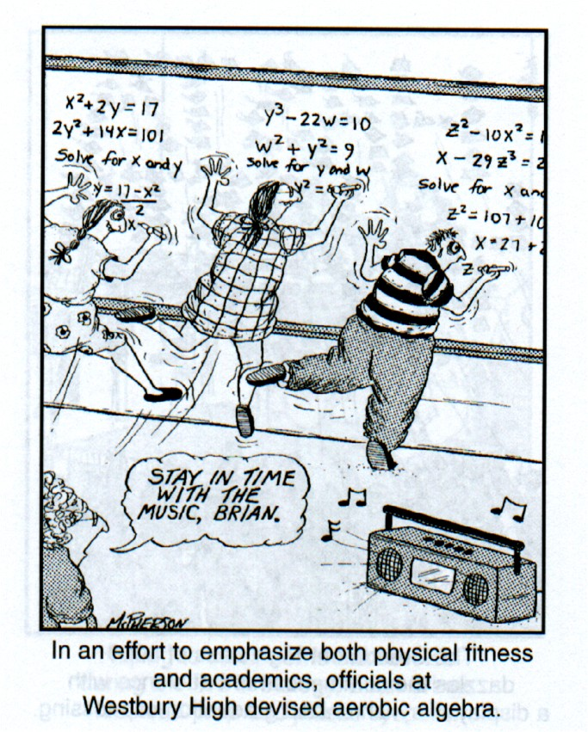
Still another way to meet the kinesthetic learner’s needs (and maybe the Phys Ed. requirement!

Slide 14
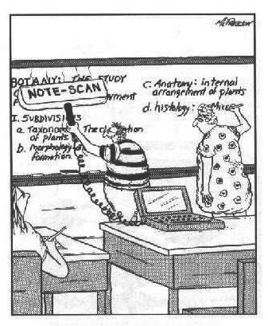
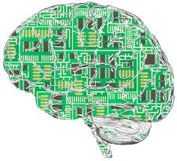
Who knows how the next generations’ brains will be wired!

Slide 15
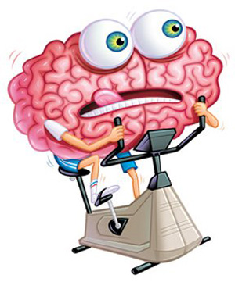
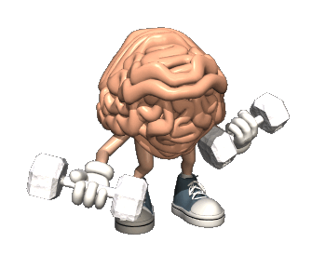
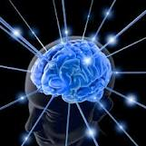
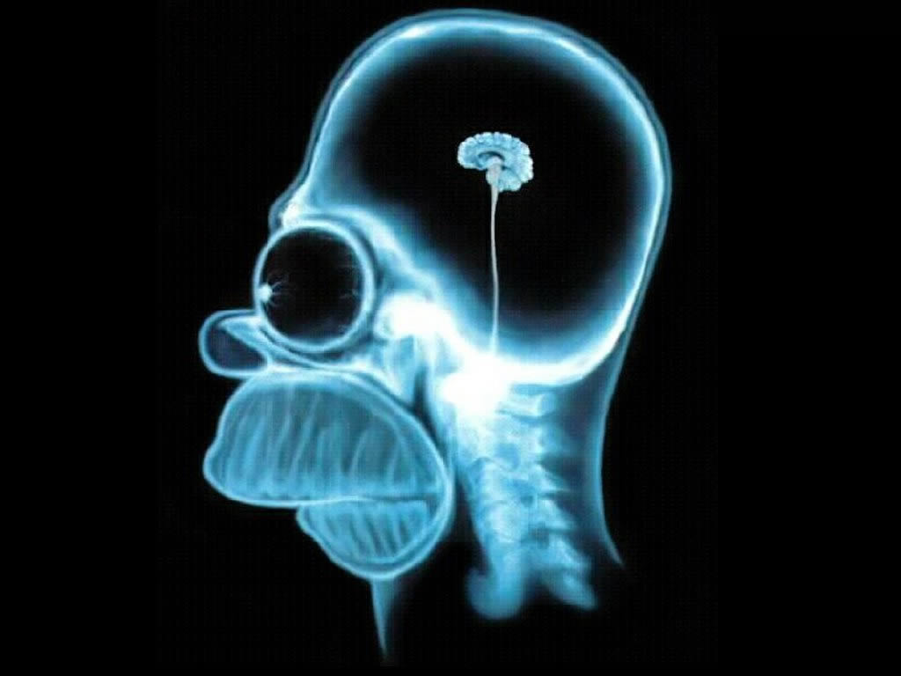
Exercise your brain
So it looks like this:
Not this:

